Slide 1
Факториал дробей и Гамма-функция Factorial of fractions and the Gamma Function
Project for educational purposes
Author: Keseli Timur, БПАД211
Supervisor: Ph. D. in Physico-Mathematical Sciences Professor at HSE, Lopatkin Viktor Evgenievich

Slide 2
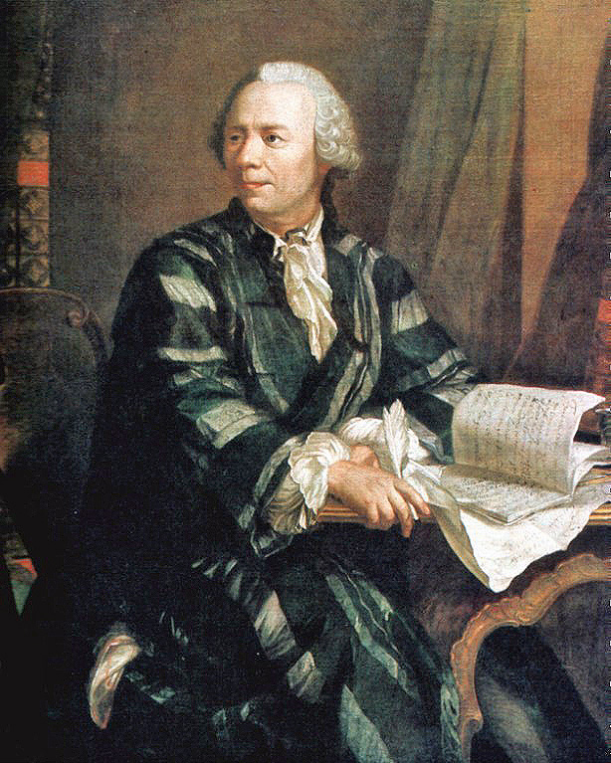
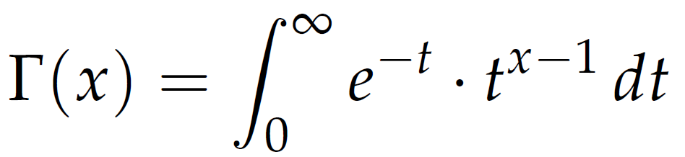
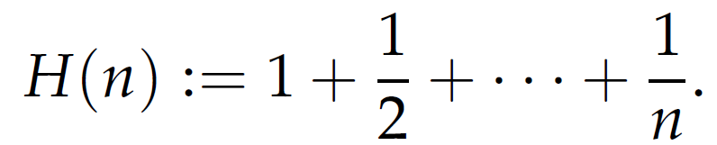
Subject Area
Euler’s formula for the Gamma Function, 1730:
Harmonic Series:
Leonard Euler, 1756

Slide 3
Relevance of the work
Unique way to derive the Gamma Function naturally
Usage in modern physics

Slide 4
Project’s Aim
Describe a natural derivation of the factorial function from the domain of the natural numbers to the real numbers.

Slide 5
Challenges of the project
Define the domain expansion of a function
Find a natural expansion of the factorial function into real number space.
Show connection with the Harmonic Series
Application in the modern physics

Slide 6
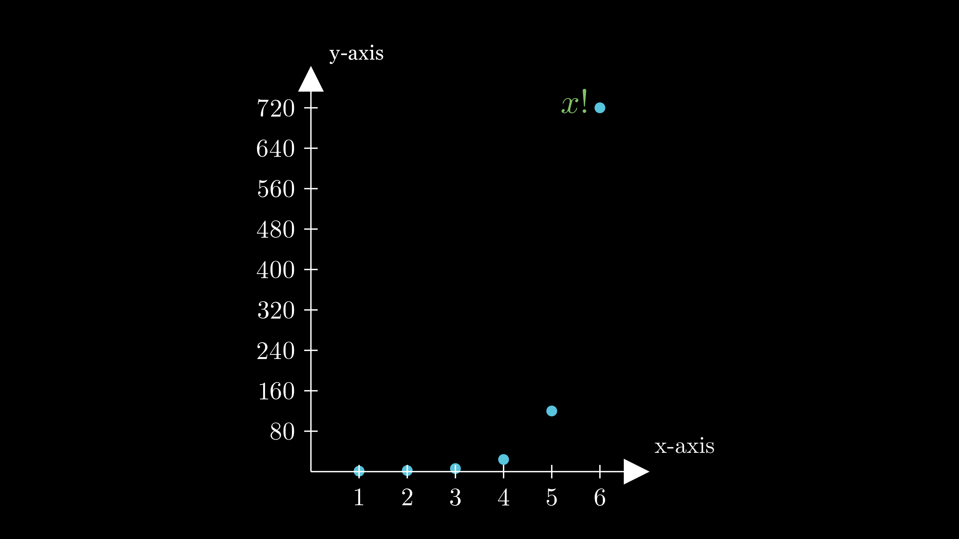
Methodology
First 5 factorials:
1! = 1
2! = 2
3! = 6
4! = 24
5! = 120

Slide 7
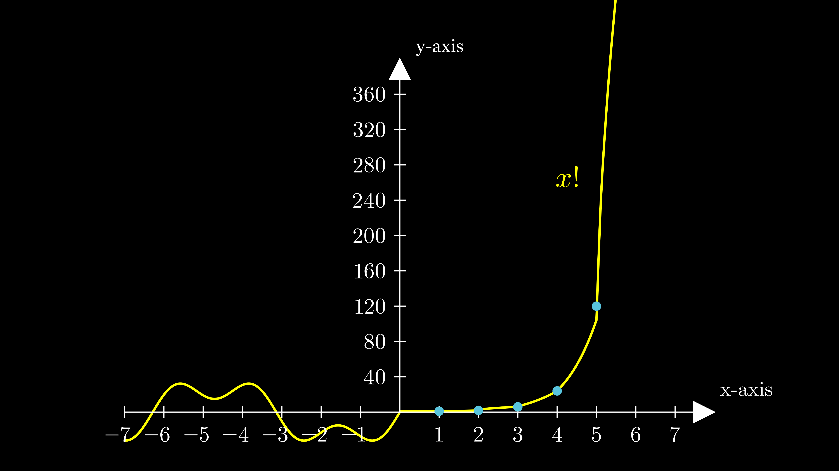
Methodology
One of the infinitely possible representations of the hypothetical extended form of the factorial function:

Slide 8
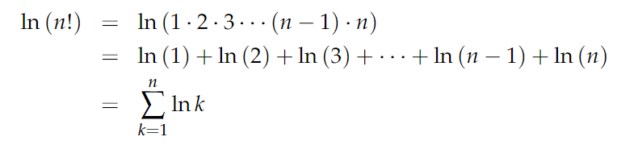
Methodology
Application of natural logarithms helps to ease the challenge of factorials spiraling out:

Slide 9
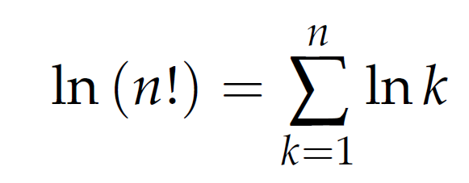
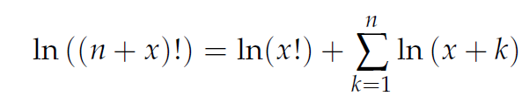
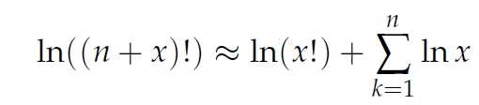
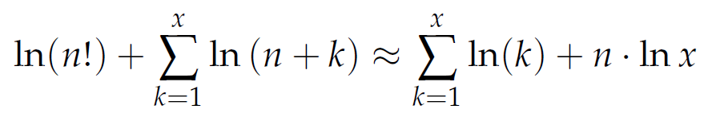
Methodology
Formula 1
Formula 2
Assumption for large enough x:
Result of applying two formulae:

Slide 10


Methodology
Definition of the Gamma Function:

Slide 11
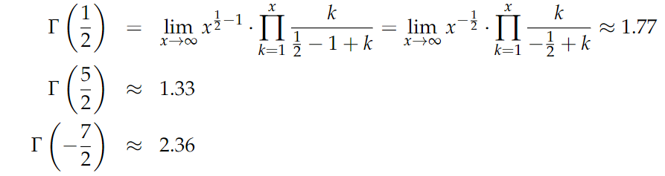
Methodology
Examples of calculating the factorials of fractions:

Slide 12
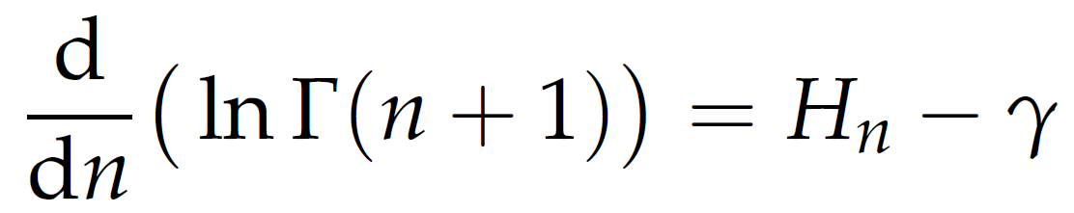
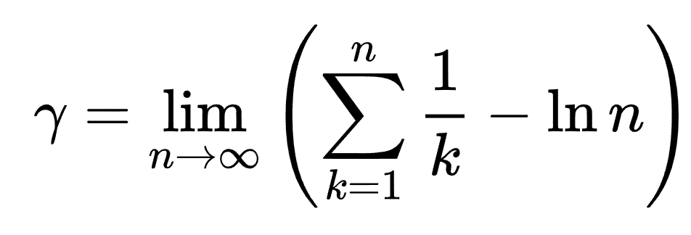
Methodology
Connection with the Harmonic function:
Euler-Mascheroni constant:

Slide 13

Modern physics
The Gamma Function helped to describe properties of strongly interacting particles. This unexplainable connection was discovered by Gabriele Veneziano in 1968.
In 1970 three scientists, Leonard Susskind, Yoichiro Nambu and Holger Nielsen gave the explanation, in which elementary particles were deemed as tiny, vibrating strings, and the Gamma Function could describe nucleus interactions.
Gabriele Veneziano

Slide 14
Results
There was described a way to naturally derive the Gamma Function from the factorial function.
The connection with the Harmonic Series was proved and there was introduced an application in modern physics.

Slide 15
References
1. Alexander Aycock. Euler and the Gamma Function. 2020.
2. Greene, B. The Elegant Universe: Superstrings, Hidden Dimensions, and the Quest for the Ultimate Theory; 2nd ed.; W. W. Norton, 2003; ISBN 0393058581
3. Huizeng Qin, Zhongfeng Sun. Some Results on the Derivatives of the Gamma and Incomplete Gamma Function for Non-positive Integers. International Journal of Applied Mathematics 2017.
4. Lines That Connect (2022) How to Take the Factorial of Any Number Available at: https://www.youtube.com/watch?v=v_HeaeUUOnc (Accessed: February, 25 2023).
5. Jamal Y. Salah. A Note on Gamma Function. pp. 58-64. In IJMSET 2015.

